Slide 1
Improving a Hypercube Structured Distributed Hash Table
James R. Wilburn
Mentor: Dr. Udaya Shankar

Slide 2
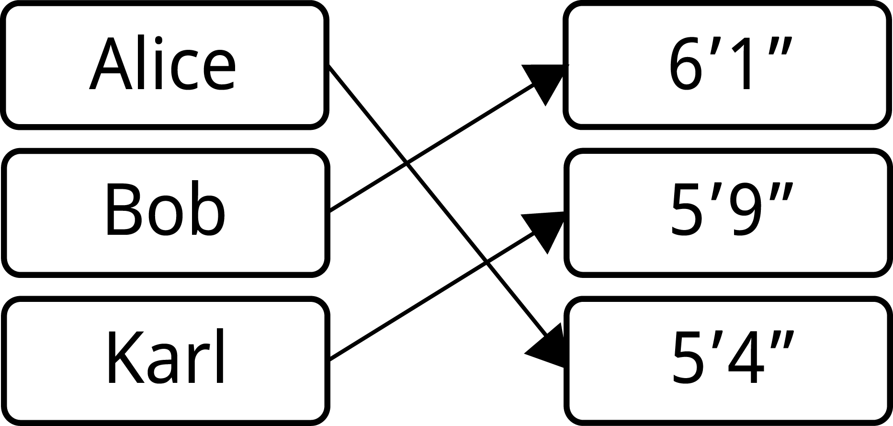
What is a Hash Table?
Store data
Map keys to values
Can get, set, or delete

Slide 3
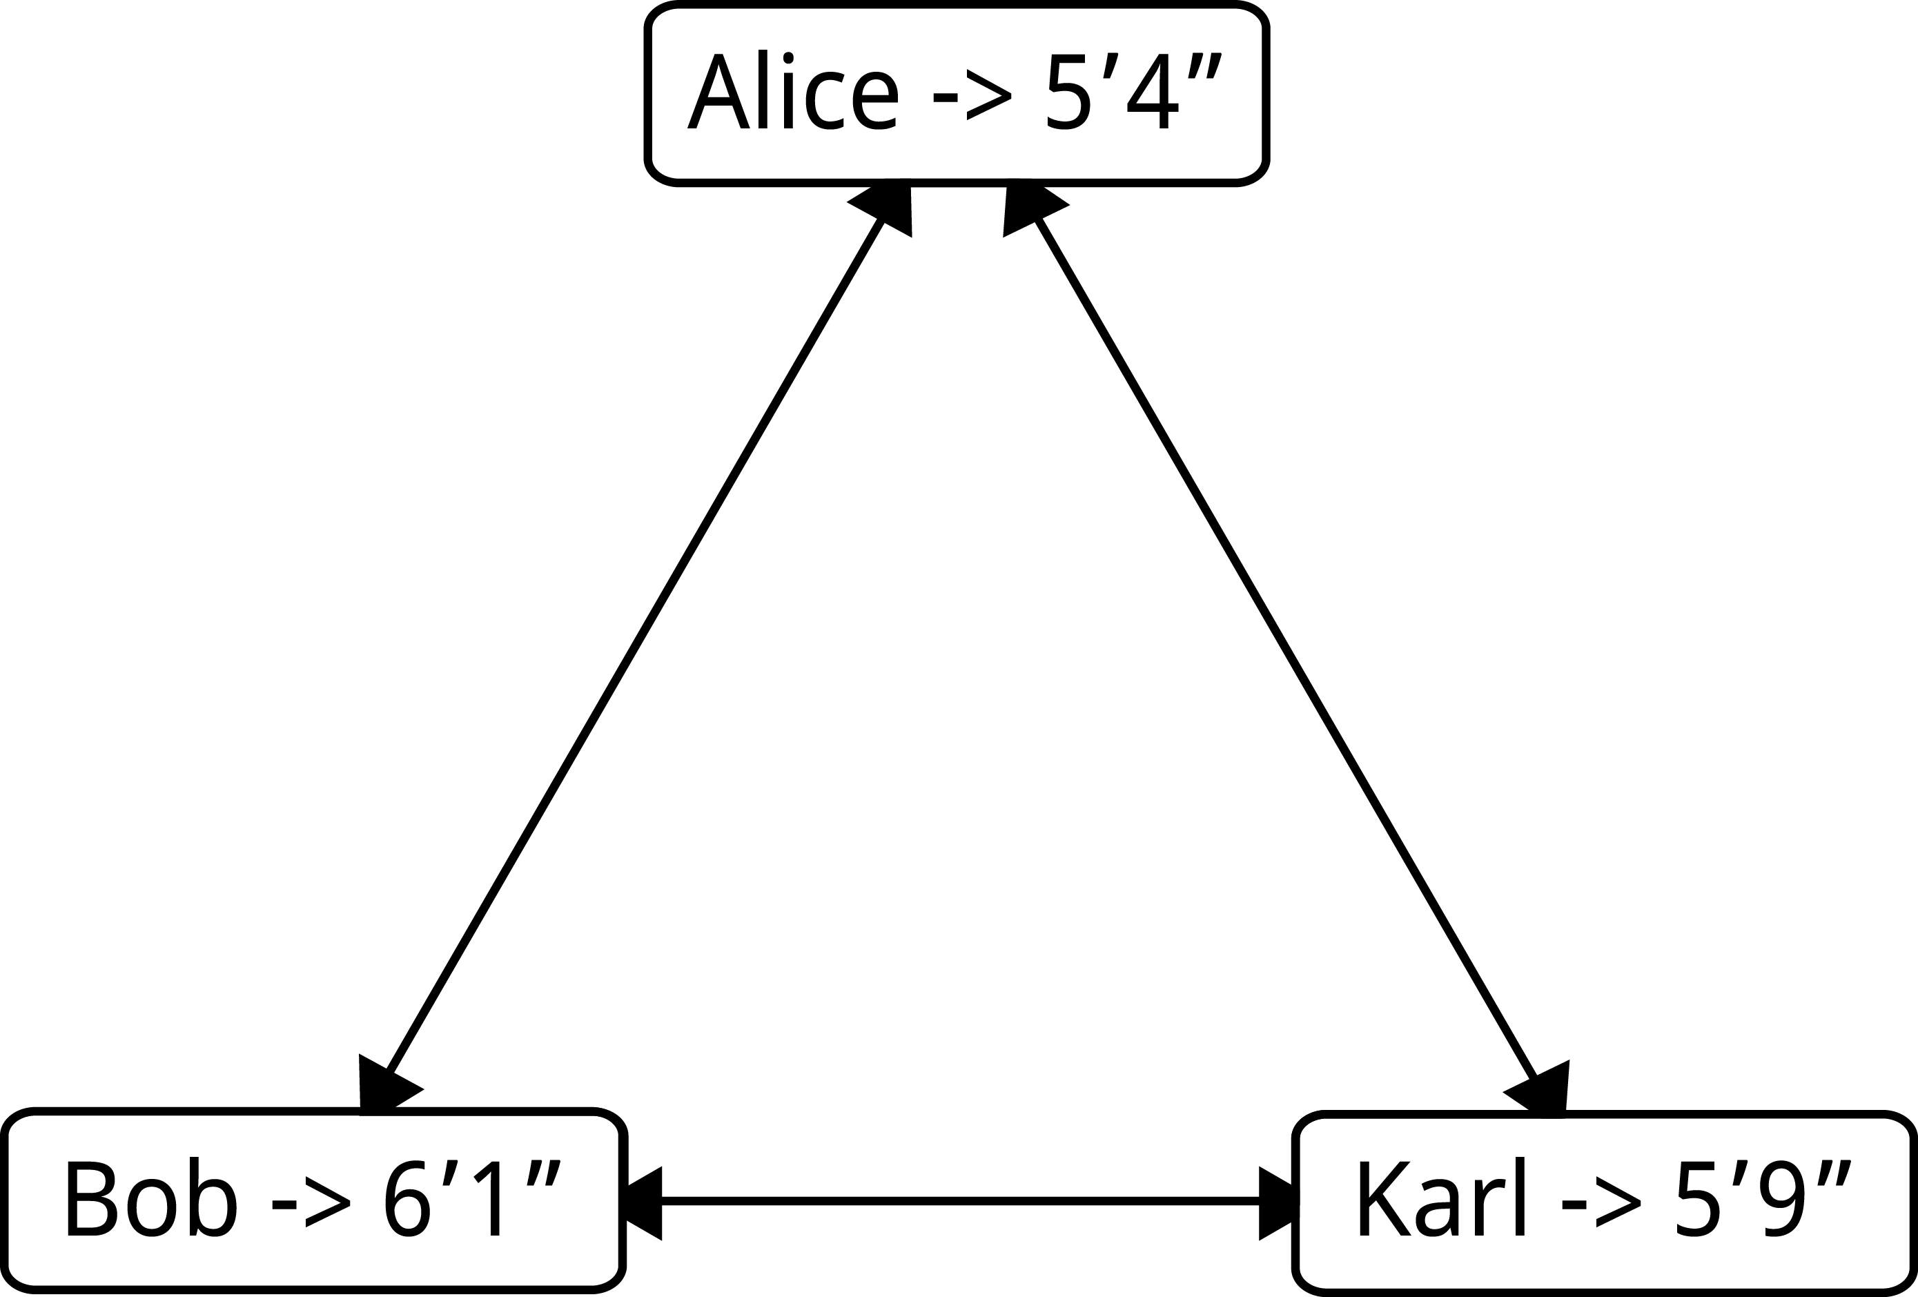
What is a Distributed Hash Table?
Transparent
Can still get, set, or delete
Data spread across a network

Slide 4
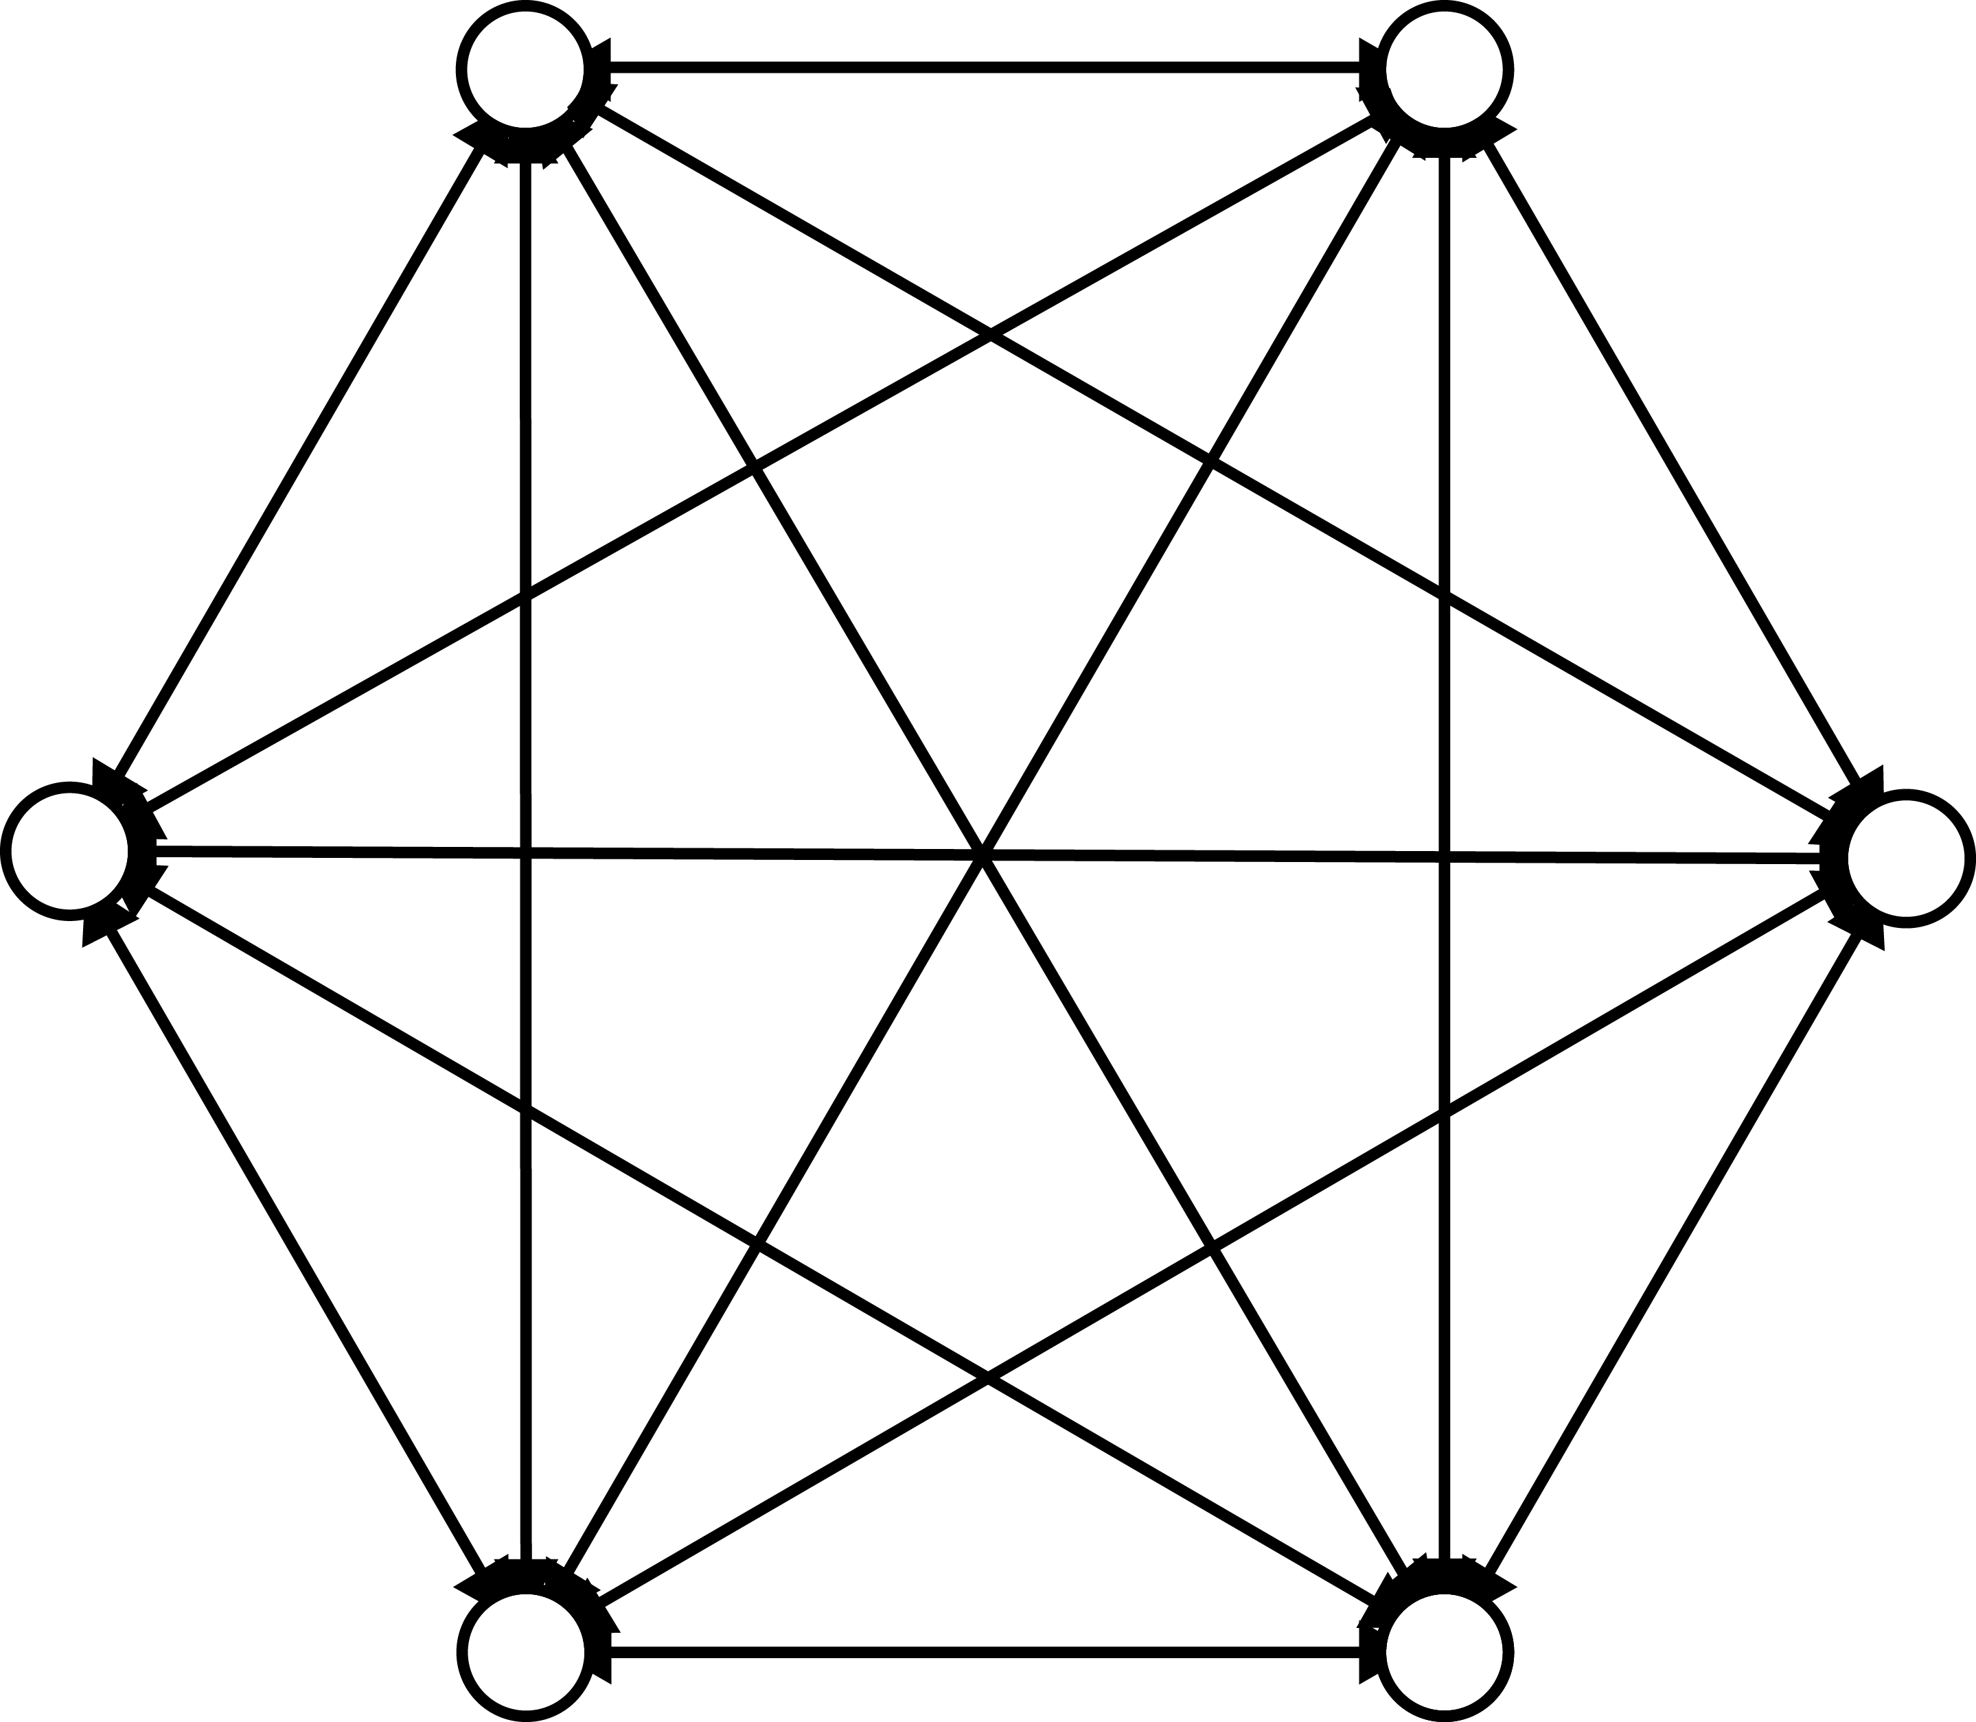
Unstructured Clusters
n vertices
n-1 edges per vertex

Slide 5
Advantages
Max distance of 1
Easy to maintain when small
Adapts to change
Redundant links

Slide 6
Disadvantages
Slow at large sizes
Search is slow

Slide 7
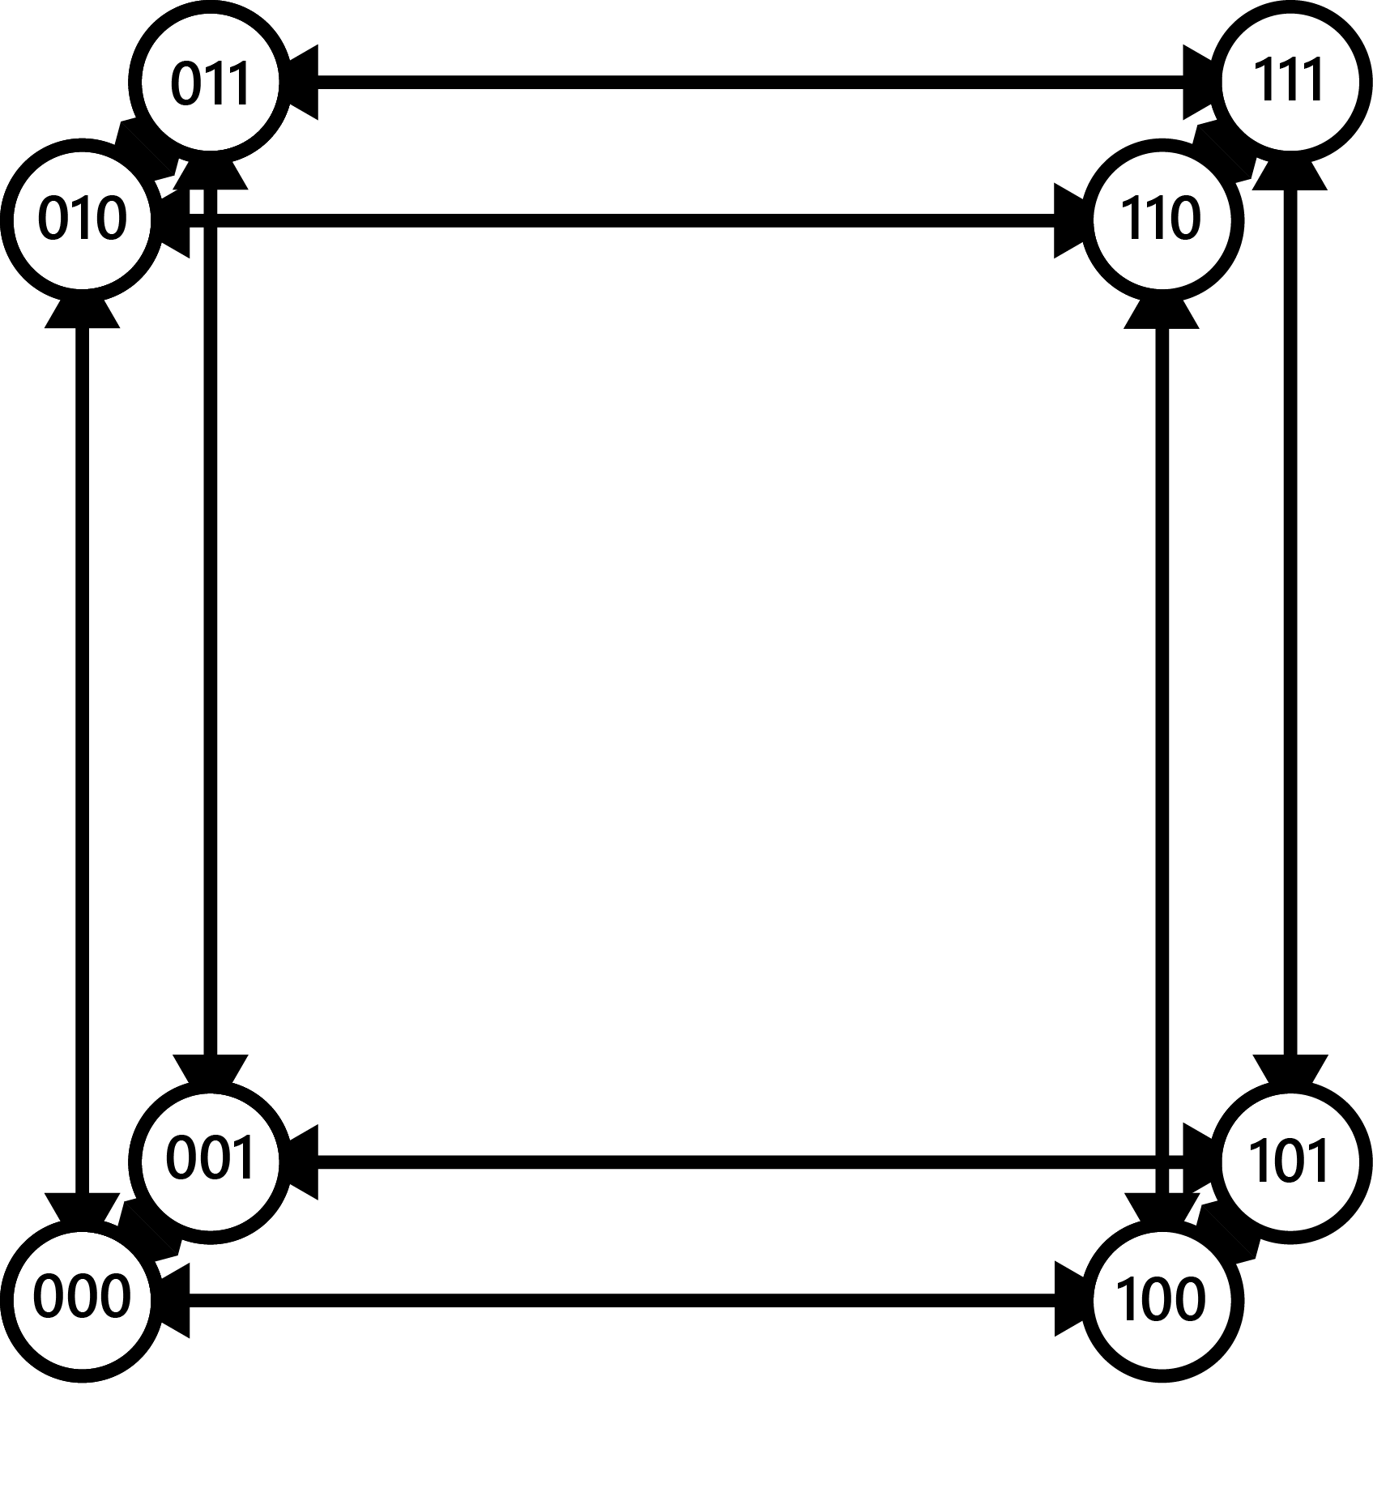
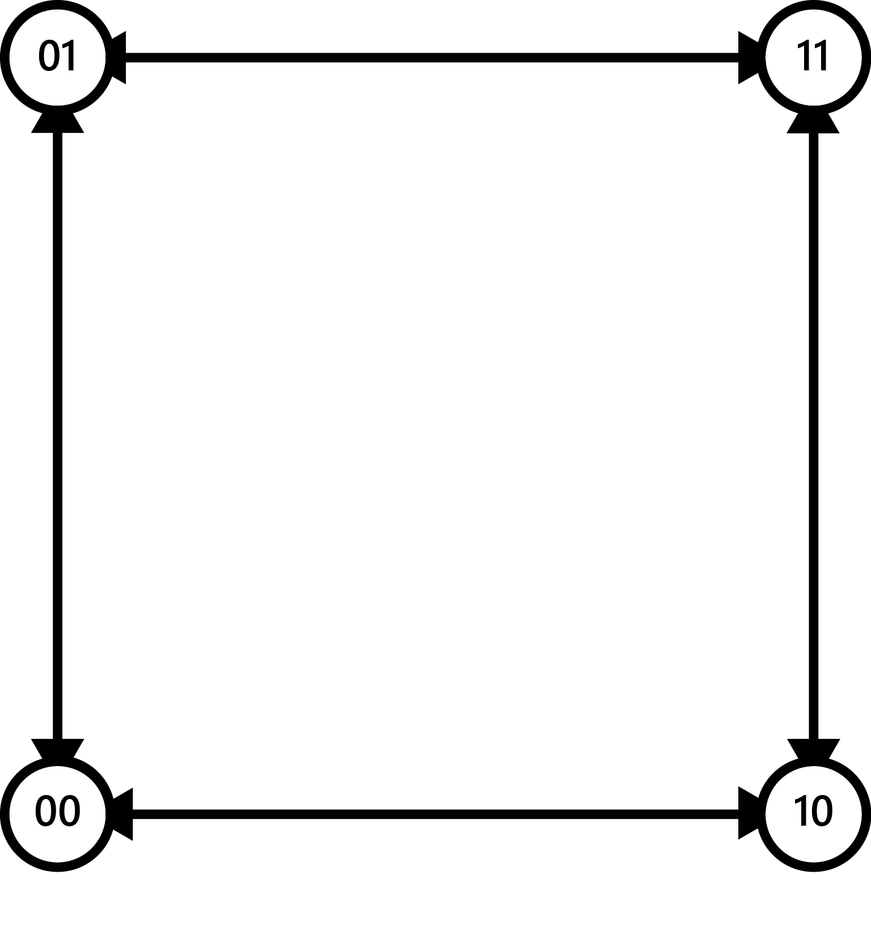
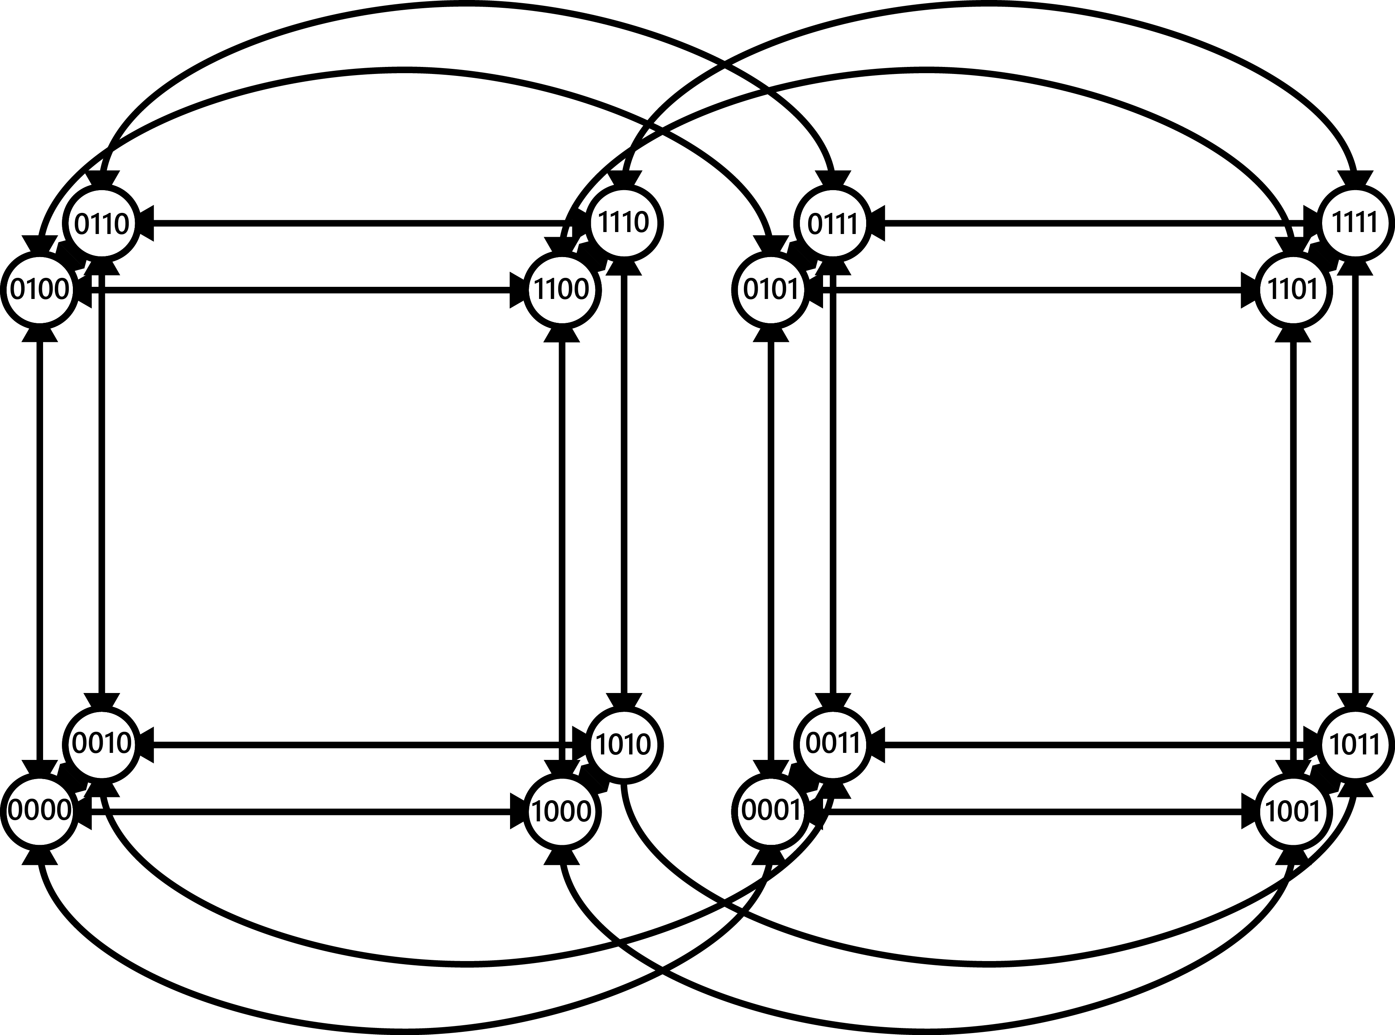
Hypercubic Networks
2^{n} vertices
n edges per vertex
Recursive design
Labelled vertices

Slide 8
Advantages
Short max distance
Redundant links
Dynamic growth
Search is fast

Slide 9
Disadvantages
Hard to maintain
Weak to change

Slide 10
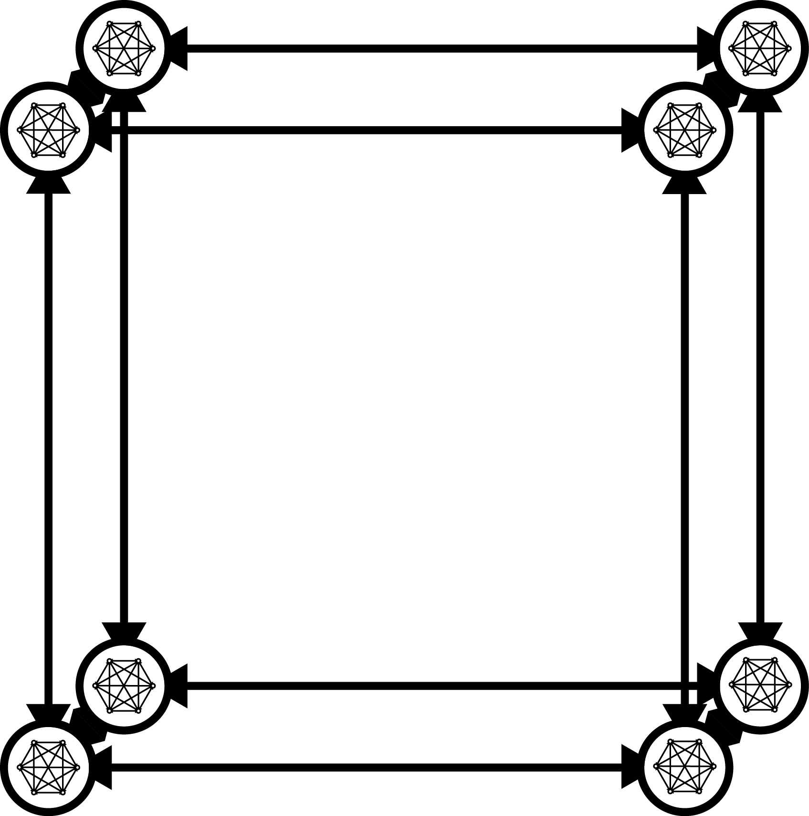
PeerCube
Cluster at each vertex
Cluster data replication
Limited cluster size

Slide 11
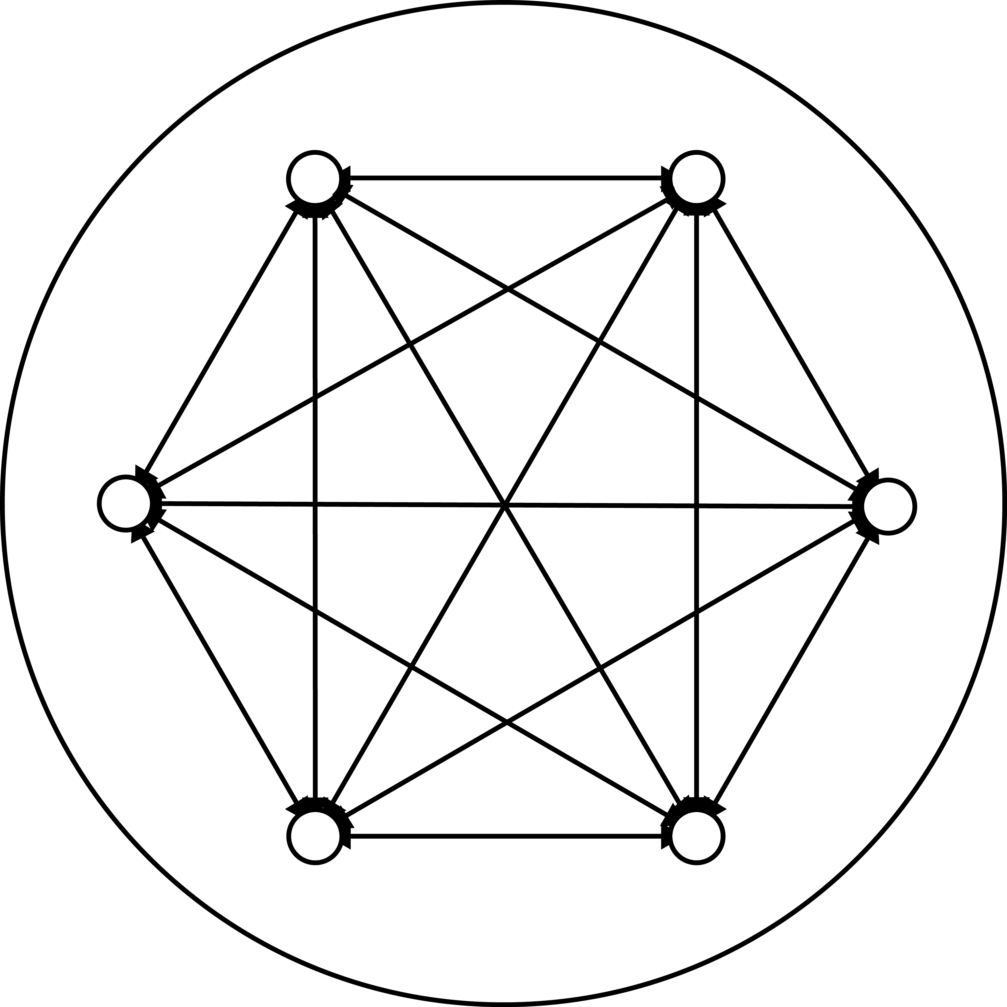
PeerCube Clusters
Grow and Shrink
Merge and Split
Share data internally
Smin and Smax

Slide 12
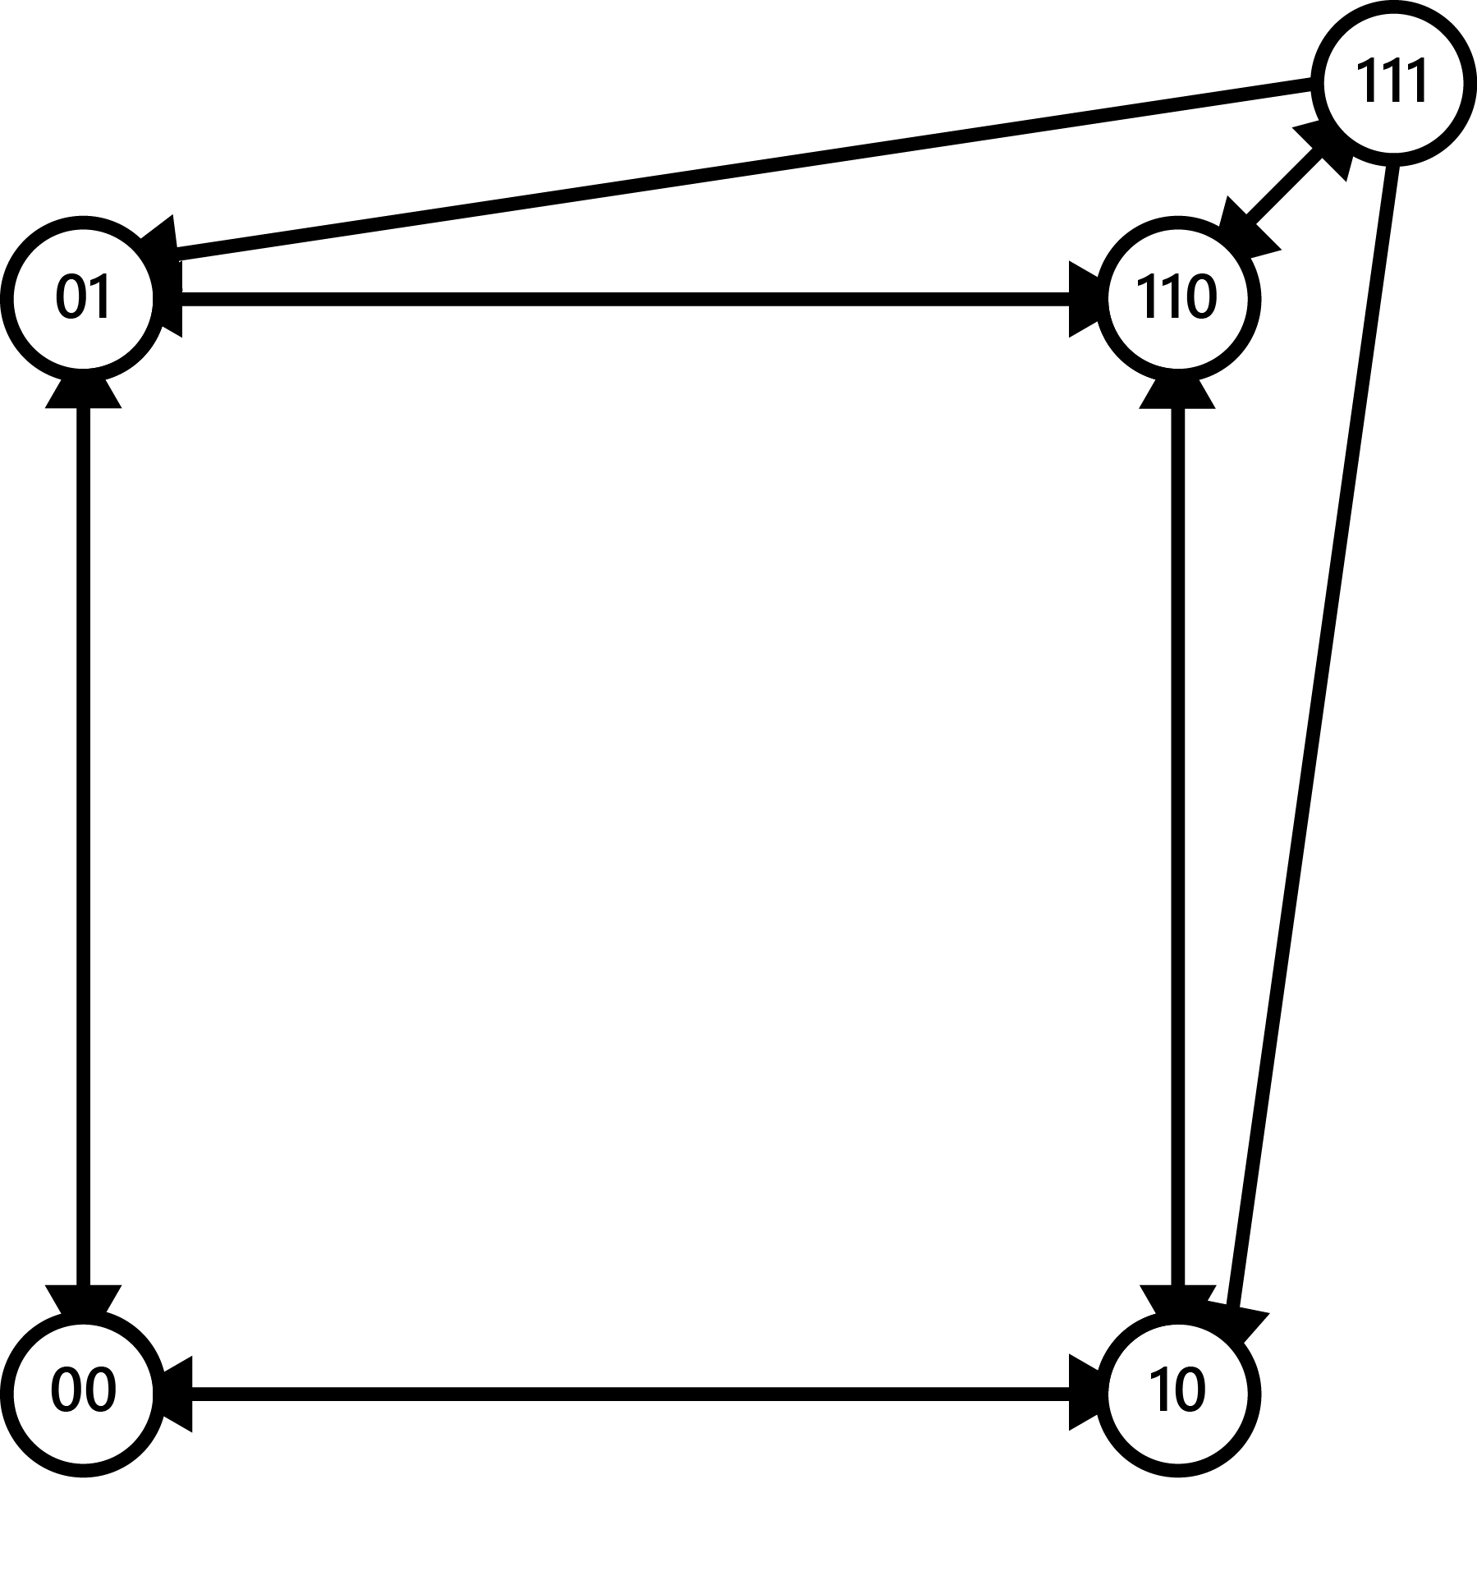
Cluster Splitting
When the cluster is larger than Smax
Makes two clusters smaller than Smax
Links can be unidirectional

Slide 13
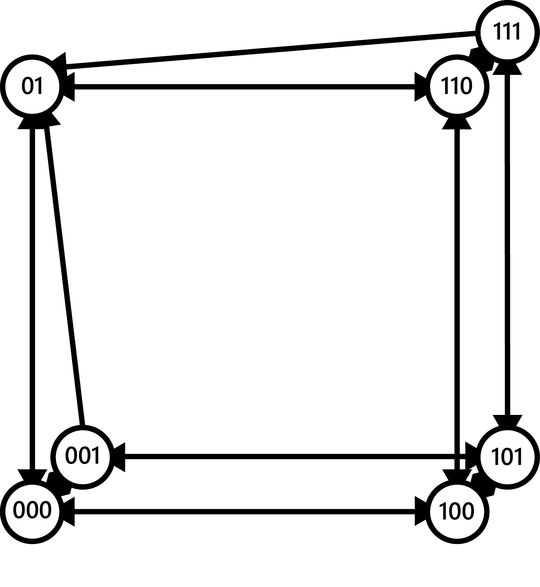
Cluster Merging
When the cluster is smaller than Smin
Makes one cluster larger than Smin
More than two clusters can merge

Slide 14
Problems
No data prioritization
All data is in memory

Slide 15
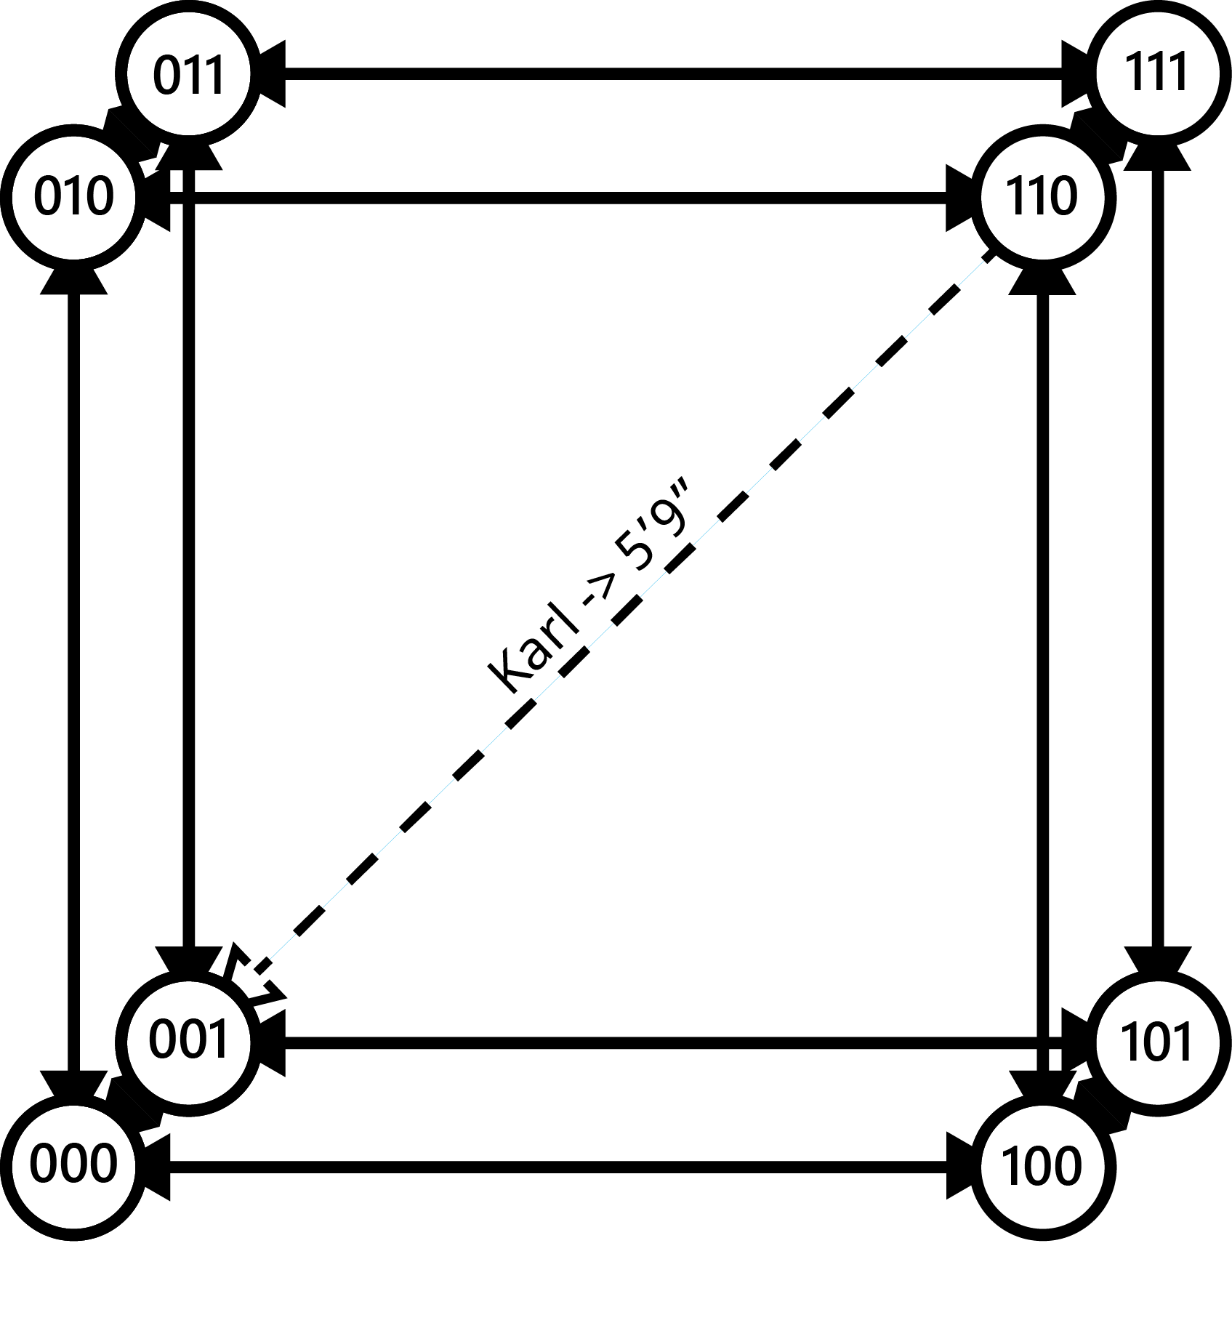
Hot Data Caching
Cache frequently accessed data
Preempt structure
Key-specific links
Latency decrease

Slide 16

Cold Data Paging
Page infrequently accessed data to disk
Saves RAM
Minimal latency increase

